Slide 1
MATHEMATICAL PROGRAMMING II
COMBINATORIAL OPTIMIZATION

Slide 2
Contents
Approximate algorithms
Submodular functions
Matroids
Multilinear extensions
Convex and Conclave closures
Continuous approximation algorithms
Rounding techniques

Slide 3
APPROXIMATE ALGORITHMS
INTRODUCTION
Definition: Given an optimization problem P, an algorithm A is said to be an approximation algorithm for P, if for any given instance I, it returns an approximate solution, that is a feasible solution.
An Approximate Algorithm is a way of approach NP-COMPLETENESS for the optimization problem.
This technique does not guarantee the best solution.
The goal of an approximation algorithm is to come as close as possible to the optimum value in a reasonable amount of time which is at the most polynomial time.
Such algorithms are called approximation algorithm or heuristic algorithm.

Slide 4
Types of approximation
P An optimization problem
A An approximation algorithm
I An instance of P
A∗ (I) Optimal value for the instance I
A(I) Value for the instance I generated by A
Absolute approximation A is an absolute approximation algorithm if there exists a constant k such that, for every instance I of P, |A∗ (I) − A(I)| ≤ k.
Eg: Planar graph coloring.
2. Relative approximation I A is an relative approximation algorithm if there exists a constant k such that, for every instance I of P, max{ A∗(I) /A(I) , A(I) /A∗(I) } ≤ k.
Eg: Vertex cover.

Slide 5
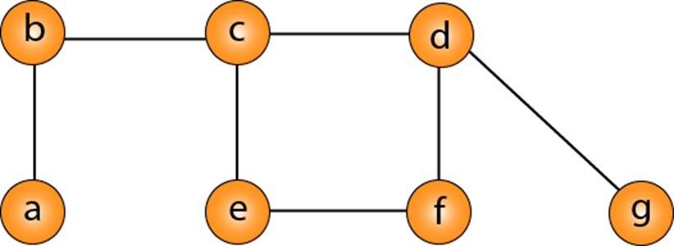
Vertex Cover
A Vertex Cover of a graph G is a set of vertices such that each edge in G is incident to at least one of these vertices.
The decision vertex-cover problem was proven NPC. Now, we want to solve the optimal version of the vertex cover problem, i.e., we want to find a minimum size vertex cover of a given graph. We call such vertex cover an optimal vertex cover C*.

Slide 6
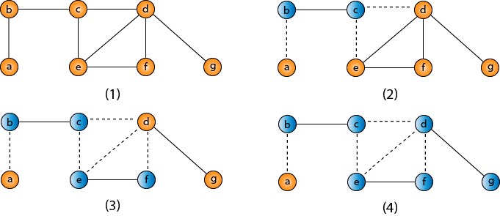
An approximate algorithm for vertex cover:
The idea is to take an edge (u, v) one by one, put both vertices to C, and remove all the edges incident to u or v. We carry on until all edges have been removed. C is a VC.
VC = {b, c, d, e, f, g}

Slide 7
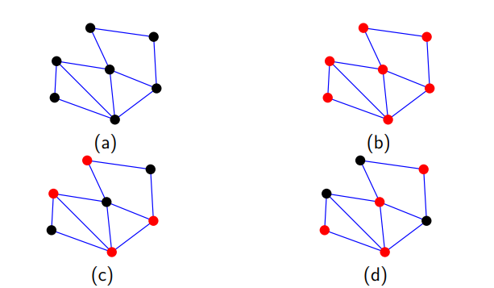
Instance An undirected graph G = (V, E).
Feasible Solution A subset C ⊆ V such that at least one vertex of every edge of G belongs C.
Value The value of the solution is the size of the cover, |C|, and the goal is to minimize it.
Figure: (a) An undirected graph (b) A trivial vertex cover
(c) A vertex cover (d) An other vertex cover

Slide 8
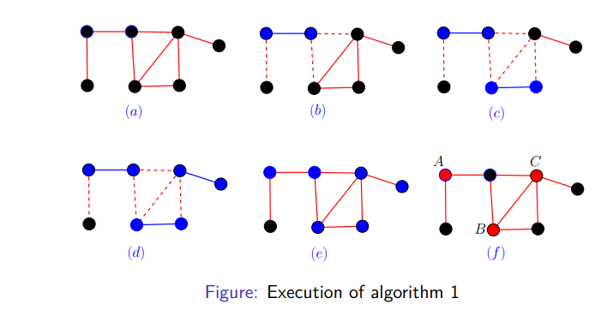
Greedy algorithm 1
1. C ← ∅
2. pick any edge (u, v) ∈ E.
3. C = C ∪ {u, v}
4. remove all edges incident on either u or v from E.
5. repeat the process till all edges are removed from E.
6. return C.
|C| = 6 (blue vertices) and |C ∗ | = 3 (red vertices)
However if we had picked the edge (B, C) we would have |C| = 4

Slide 9
Performance analysis of algorithm 1
The edges picked by the algorithm is a maximal matching (say M), hence C is a vertex cover.
The algorithm runs in time polynomial of input size.
The optimum vertex cover (say C ∗ ) must cover every edge in M.
Hence C ∗ contains at least one of the end points of each edge in M, implies
|C ∗ | ≥ |M|.
5. |C| = 2 ∗ |M| ≤ 2 ∗ |C ∗ |, where C ∗ is an optimal solution.
6. Thus there is a 2-factor approximation algorithm for vertex cover problem.

Slide 10
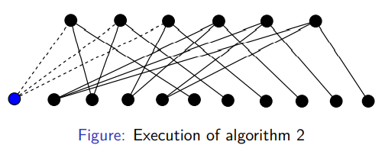
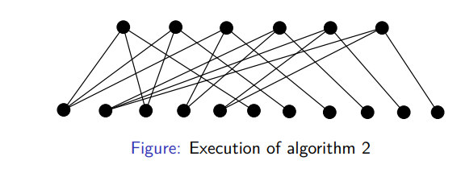
Greedy algorithm 2
C ← ∅
2. Take a vertex v ∈ V of maximum degree (tie can be broken arbitrarily).
3. C = C ∪ {v}
4. remove all edges incident on v from E.
5. repeat the process till all edges are removed from E.
6. return C.

Slide 11
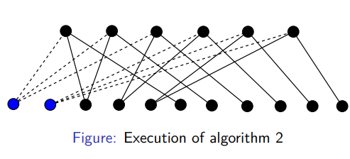
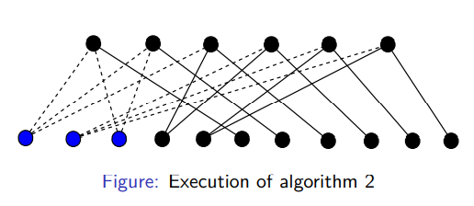
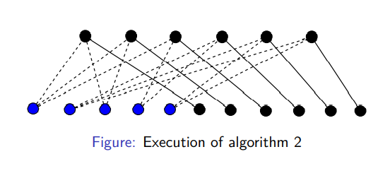
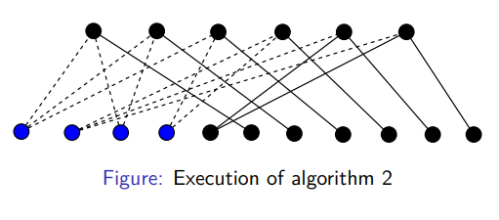

Slide 12
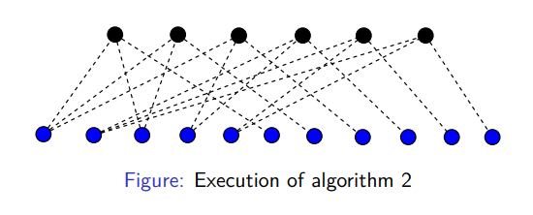
Performance algorithm 2
1. The vertices picked by the algorithm forms a vertex cover.
2. The algorithm runs in polynomial time of input size.
3. Optimum solution C ∗ contains all top vertices, |C ∗ | = k!.
4. Solution C given by algorithm 2 contains all bottom vertices.
5. Hence |C| = k!( 1 k + 1 (k−1 + · · · + 1) ≈ k! log k = log k | C ∗ |

Slide 13
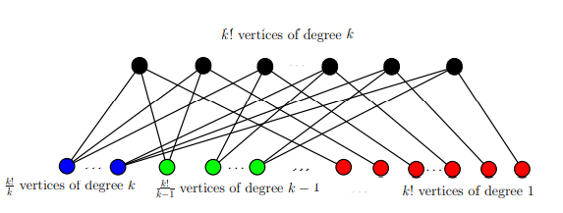
Generalizing the previous example
Design an approximation algorithm which gives a better approximation.
A better approximation ratio for the vertex cover problem by [Karakostas, 2009] (Ratio : 2 − √ 1 log n )
There is no α-approximation algorithm for vertex cover with α < 7/6 unless P = NP [H˚astad, 2001].

Slide 14
In the traveling salesman Problem, a salesman must visits n cities. We can say that salesman wishes to make a tour or Hamiltonian cycle, visiting each city exactly once and finishing at the city he starts from. There is a non-negative cost c (i, j) to travel from the city i to city j. The goal is to find a tour of minimum cost. We assume that every two cities are connected. Such problems are called Traveling-salesman problem (TSP).
For the traveling salesperson problem, the optimization problem is to find the shortest cycle, and the approximation problem is to find a short cycle.
For the vertex cover problem, the optimization problem is to find the vertex cover with fewest vertices, and the approximation problem is to find the vertex cover with few vertices.

Slide 15
Approx-TSP (G= (V, E))
{
1. Compute a MST T of G;
2. Select any vertex r is the root of the tree;
3. Let L be the list of vertices visited in a preorder tree walk of T;
4. Return the Hamiltonian cycle H that visits the vertices in the order L
}

Slide 16
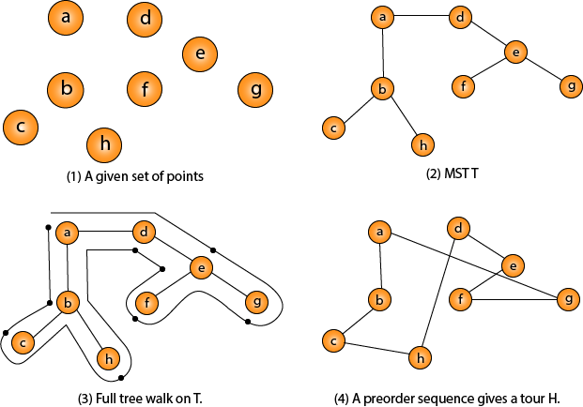
Traveling-salesman Problem
Note: Intuitively, Approx-TSP first makes a full walk of MST T, which visits each edge exactly two times. To create a Hamiltonian cycle from the full walk, it bypasses some vertices (which corresponds to making a shortcut)

Slide 17
Hard to approximate
For any c > 1, there is no polynomial time algorithm which can approximate TSP within a factor of c, unless P = NP.
In fact, the existence of an O(2 n ) - approximation algorithm would imply that
P = NP. I
Eg: A simple reduction from Hamiltonian cycle.
Easy to approximate
If edge weights satisfy triangle inequality.
The triangle inequality holds in a (complete) graph with weight function w on the edges if for any three vertices u, v, x in the graph w(u, v) ≤ w(u, x) + w(x, v).
TSP with triangle inequality is also known as Metric TSP.
Metric TSP is still NP-hard (Non deterministic polynomial), but now we can approximate.

Slide 18
Definition of NP class Problem: - The set of all decision-based problems came into the division of NP Problems who can't be solved or produced an output within polynomial time but verified in the polynomial time. NP class contains P class as a subset. NP problems being hard to solve. (one input number of outputs).
Definition of P class Problem: - The set of decision-based problems come into the division of P Problems who can be solved or produced an output within polynomial time. P problems being easy to solve.
Definition of Polynomial time: - If we produce an output according to the given input within a specific amount of time such as within a minute, hours. This is known as Polynomial time.

Slide 19
Relation of P and NP classes
P contains in NP
P=NP
3. Observe that P contains in NP. In other words, if we can solve a problem in polynomial time, we can indeed verify the solution in polynomial time. More formally, we do not need to see a certificate (there is no need to specify the vertex/intermediate of the specific path) to solve the problem; we can explain it in polynomial time anyway.
4. However, it is not known whether P = NP. It seems you can verify and produce an output of the set of decision-based problems in NP classes in a polynomial time which is impossible because according to the definition of NP classes you can verify the solution within the polynomial time. So this relation can never be held.

Slide 20

TSP is Non deterministic polynomial Class (NPC)
Model the cities as a complete graph of n vertices, where each vertex represents a city.
If we assume the cost function c satisfies the triangle inequality, then we can use the following approximate algorithm.
Triangle inequality
Let u, v, w be any three vertices, we have
One important observation to develop an approximate solution is if we remove an edge from H*, the tour becomes a spanning tree.

Slide 21



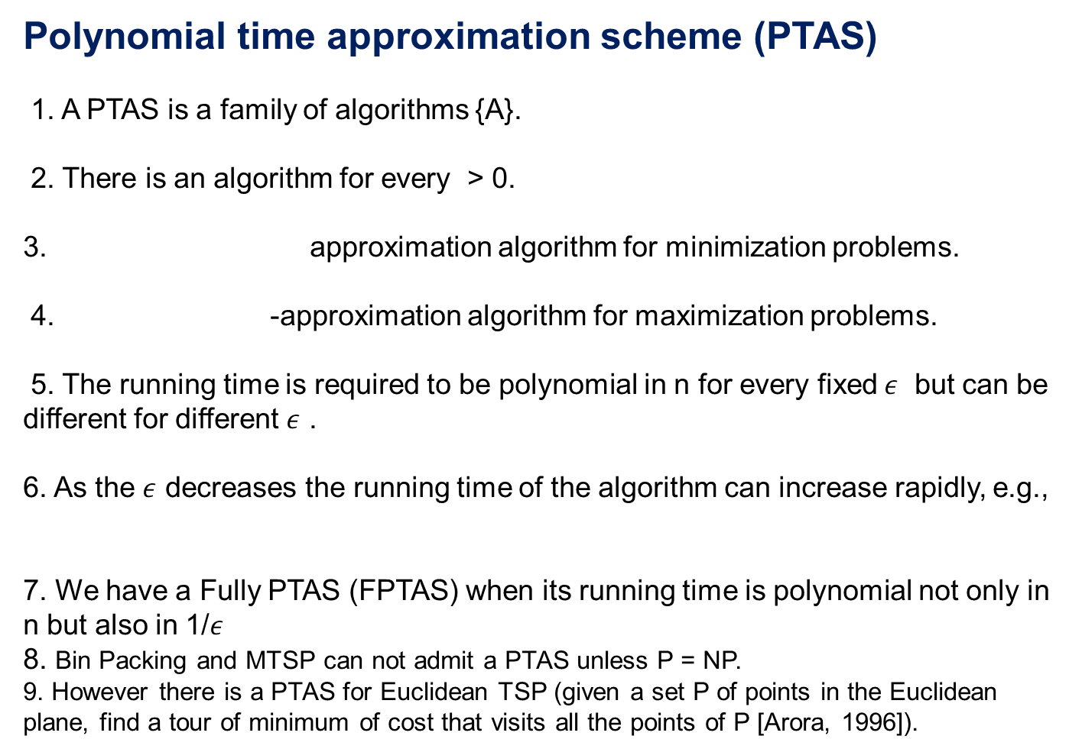
Polynomial time approximation scheme (PTAS)
1. A PTAS is a family of algorithms {A}.
2. There is an algorithm for every > 0.
3. approximation algorithm for minimization problems.
4. -approximation algorithm for maximization problems.
5. The running time is required to be polynomial in n for every fixed$ε$ but can be different for different $ε$ .
6. As the $ε$ decreases the running time of the algorithm can increase rapidly, e.g.,
7. We have a Fully PTAS (FPTAS) when its running time is polynomial not only in n but also in 1/$ε$
8. Bin Packing and MTSP can not admit a PTAS unless P = NP.
9. However there is a PTAS for Euclidean TSP (given a set P of points in the Euclidean plane, find a tour of minimum of cost that visits all the points of P [Arora, 1996]).

Slide 22
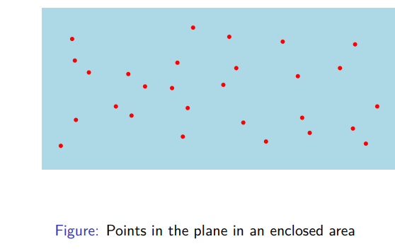
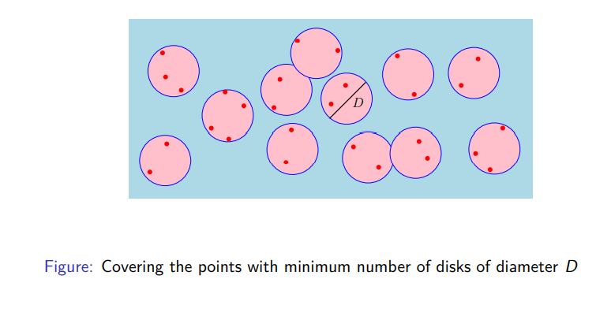
Shifting Strategy [Hochbaum and Maass, 1985]

Slide 23
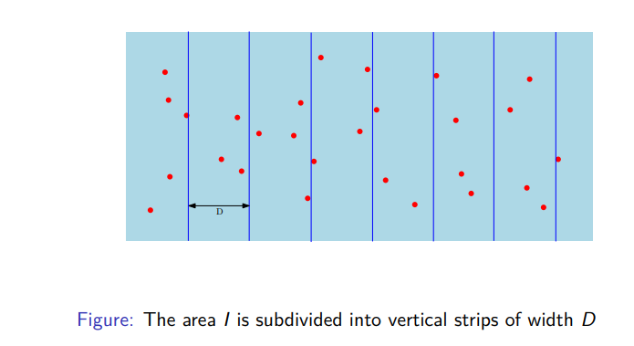

Slide 24
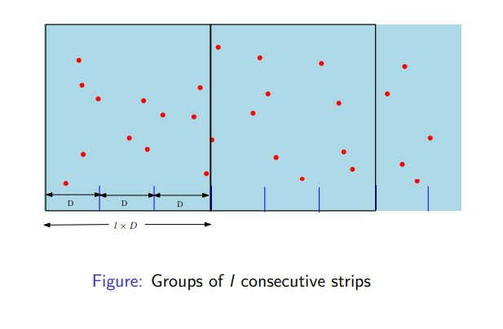

Slide 25
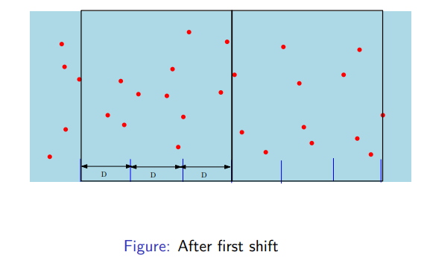
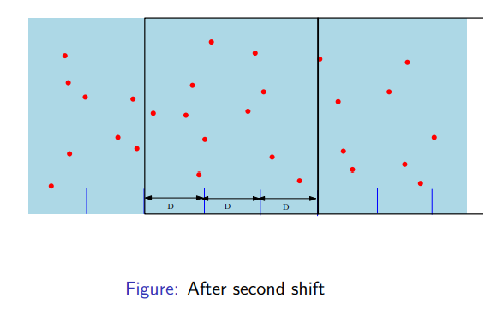
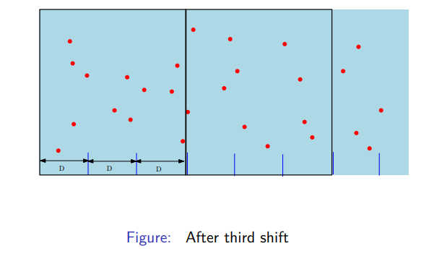

Slide 26
Conclusion
Basics of approximation.
2. Types of approximation
3. Approximation algorithms
4. Vertex cover, TSP along with examples.
5. PTAS

Slide 27
References
The Design of Approximation Algorithms by David P. Williamson and David B. Shmoys, First Edition, 2011.
2. Geometric Approximation Algorithms by Sariel Har-Peled, First Edition, 2011.
3. Approximation Algorithms by Vijay V. Vazirani, First Edition. R
4. Arora, S. (1996). Polynomial time approximation schemes for euclidean tsp and other geometric problems. In Foundations of Computer Science, 1996. Proceedings., 37th Annual Symposium on, pages 2–11. IEEE.
5. H˚astad, J. (2001). Some optimal inapproximability results. Journal of the ACM (JACM), 48(4):798–859.
6. Hochbaum, D. S. and Maass, W. (1985). Approximation schemes for covering and packing problems in image processing and VLSI. Journal of the ACM (JACM), 32(1):130–136.
7. Karakostas, G. (2009). A better approximation ratio for the vertex cover problem. ACM Transactions on Algorithms (TALG), 5(4):41.

Slide 28
THANK YOU

